Slide 1
Employee Management System PROJECT CO-ORDINATOR: PROJECT SUBMITED JUNIE SOLOMON S.ANITHA.

Slide 2
Employee Management System
Introduction:
Employee Management System is a distributed application, developed to maintain the details of employee working in any organization.
It maintains the information about the personal and official details of the employees.

Slide 3
Employee Management system
OBJECTIVE OF THE PROJECT:-
This main objective of the system is to computerize the maintenance of the employee details and add the employee, update the employee details, delete the employee, and their salary. It also includes the details about the employee personal.
To develop an well-designed database to store employee information.
Provides full functional reports to management of company.

Slide 4
EMPLOYEE MANAGEMENT SYSTEM
STRUCTURE OF THE PROJECT:-
Admine :-
This is the main module in the proposed project. The administrator can read and write information about any number such as employee, manager and staff of the company. They can also update, create, delete the record of members as requirement and implementation plan.
Employee:-
It contains details of employee who are update, delete, add.
It contains details of employee salary slip.

Slide 5
EMPLOYEE MANAGEMENT SYSTEM
PROPOSED OF PROJECT:-
Helps in maintaining the computerized employee details.
Easy attendance marking.
Computerized Event Requests Management.
Calculate the salary.

Slide 6
EMPLOYEE MANAGEMENT SYSTEM
ADVANTAGE OF PROJECT:-
Minimize handwritten work from admission to leave company.
It helps you to minimize your repeated works and take care of the complete functionality of your company.
Provide computerized system fir maintaining records.
Avoided Human storage with less computer memory.

Slide 7
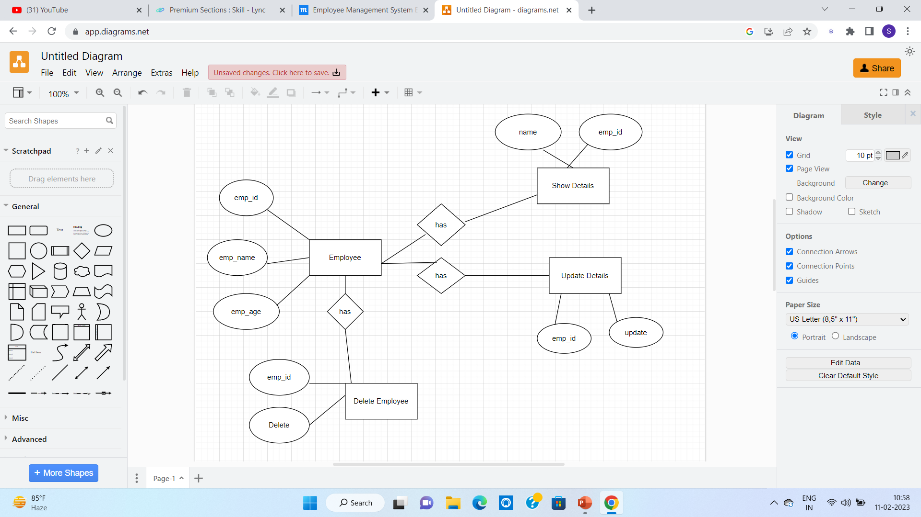
EMPLOYEE MANAGEMENT SYSTEM

Slide 8
EMPLOYEE MANAGEMENT SYSTEM
THANK YOU

